Slide 1
SDMC
January 27, 2021

Slide 2
Agenda
Returning F2F – Cycle 4
School Budget
Planning for Next School Year
Enrollment
Master Schedule
Possible New Positions

Slide 3
Returning Face-to-Face
By Grade Level
Grade | Remain Virtual | In Person | Difference | Total
6 | 155 | 160 | + 7 | 315
7 | 205 | 170 | + 13 | 375
8 | 215 | 122 | + 15 | 337
Total | 575 | 452 | +35 | 1027

Slide 4
Budget – Enrollment
Grade Level | Projected Pre-COVID | Actual
6th | 375 | 315
7th | 360 | 375
8th | 340 | 337
Total | 1075 | 1027
1075-1027= 48 students
48 X 3638= $174,624
$174,624/2= $87,312

Slide 5
Budget
Budget
Starting Balance | 248,924
Stipends
Department Chairs, UIL | 10,000
Athletics | 57,000
Extra Duty Pay
Admin Duty | 9,000
Clerk Duty | 6,280
Associate Teachers
4 Teachers | 32,400
Balance | 134, 244

Slide 6
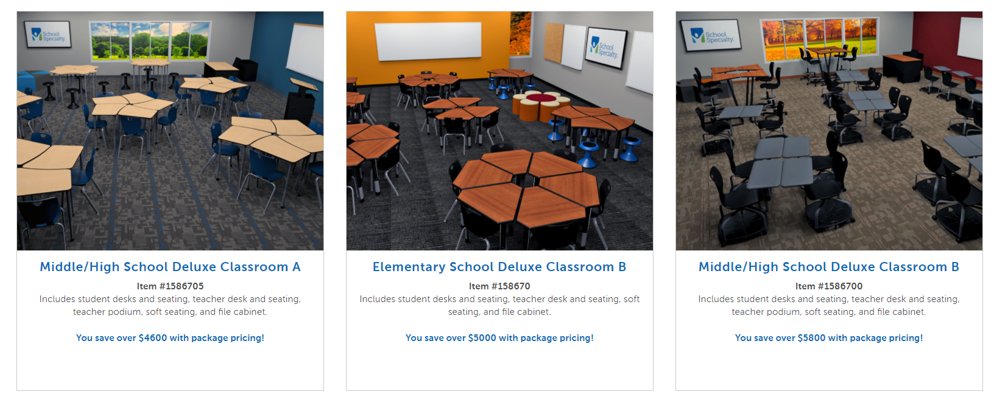
Possible Purchases
Technology
We need 215 more devices for each student to have their own device.
Laptops - $952
Chromebooks - $316
Furniture
Classroom Desks
Cafeteria Tables

Slide 7
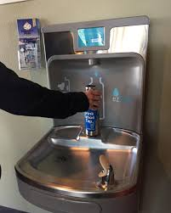
Possible Purchases
3 Refillable Water Fountains - $18,000
Any suggestions?

Slide 8
Master Schedule
Master Schedule Models
Simultaneous/Concurrent
Virtual only & Face-to-Face only
Combination of Virtual and F2F
Creating Tracks

Slide 9
Possible New Positions
Texas History Teacher
Interventionist
Social Worker / Counselor

